Slide 1
Machine Learning INT254 Human Activity Recognition Using Smartphone Dataset
Avinesh (12017005)
Akash Kumar Gupta (12011223)

Slide 2
Problem Statement
Problem Type: Activity Recognition
Platform:Jupyter + WSL
Language:Python

Slide 3
Recognition SYSTEM
One of the most used machine learning algorithms is recognition systems.
A recognition system or engine is an AI system which aim is to recognize
a variable from a set of signals. Which type of recognition can we have? In this project, I’ve provided a system to recognize the activity a user is performing using data from smartphone sensors.

Slide 4
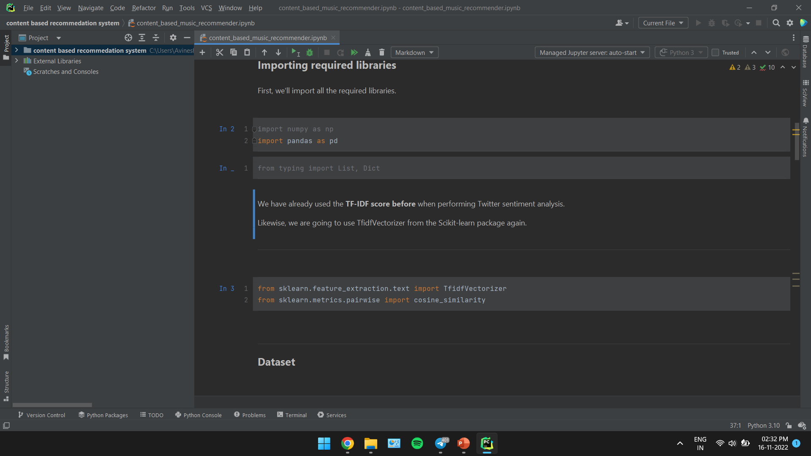
CODE

Slide 5
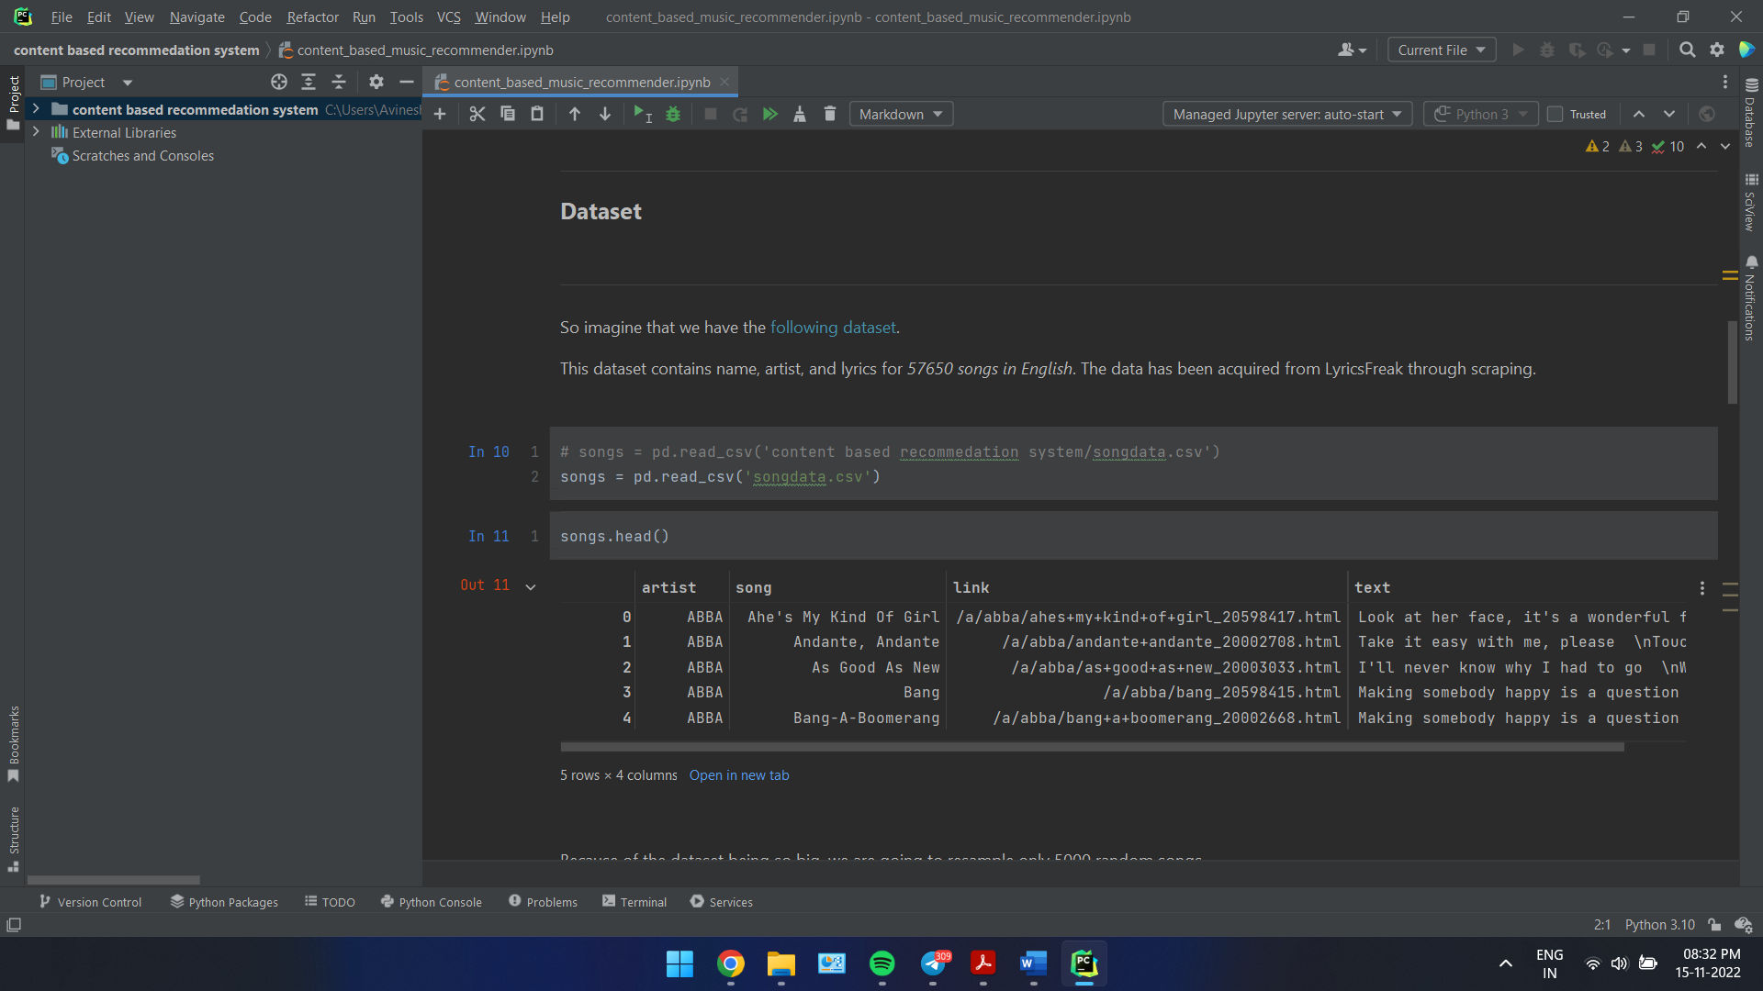

Slide 6
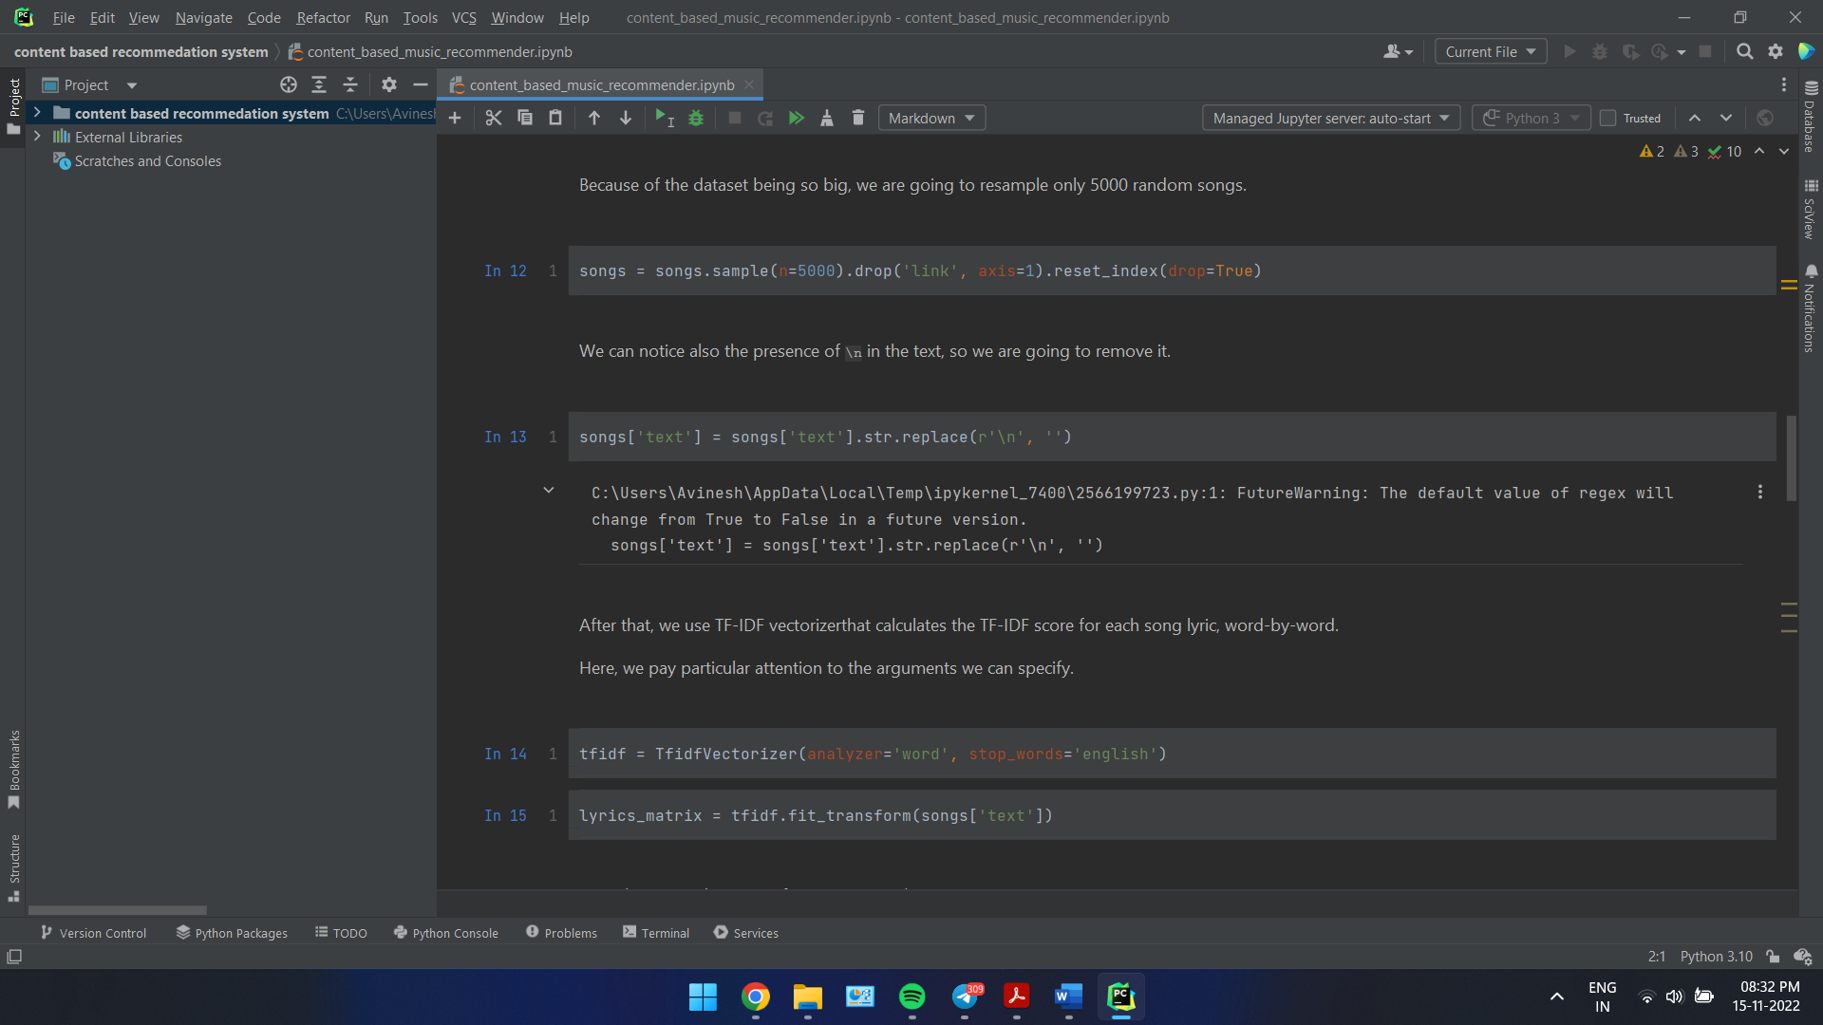

Slide 7
Thank You

